Slide 2
Why Sewage-Free Streets and Rivers
What do you get when you mix one gallon of water with one gallon of sewage?

Slide 3
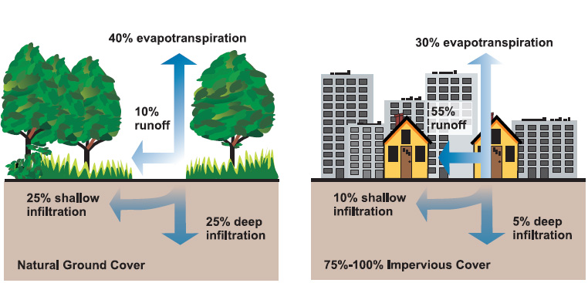
Sst
What Happens to Runoff in Cities?

Slide 4
What Are Combined Sewer Overflows (CSOs)?
Notes:
Estimated 23 billion gallons of raw sewage into NJ waterways annually

Slide 5
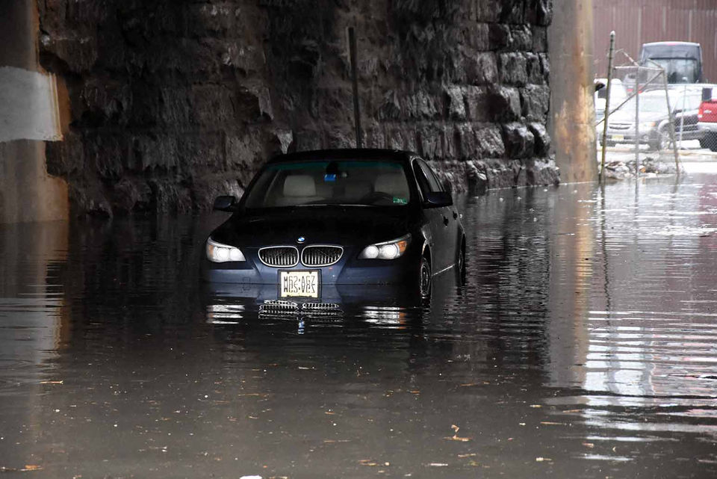
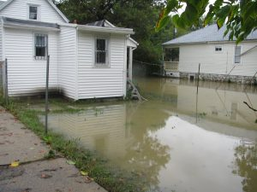
What Are the Impacts of CSOs?
On Our Neighborhoods – localized flooding, water main breaks, impaired water quality and contamination.
On Our Economy - hurts businesses, impedes transportation
On Our Health - fouls waterways, polluted flooding
On Our Future – not able to handle increased rainfall and a changing climate

Slide 6
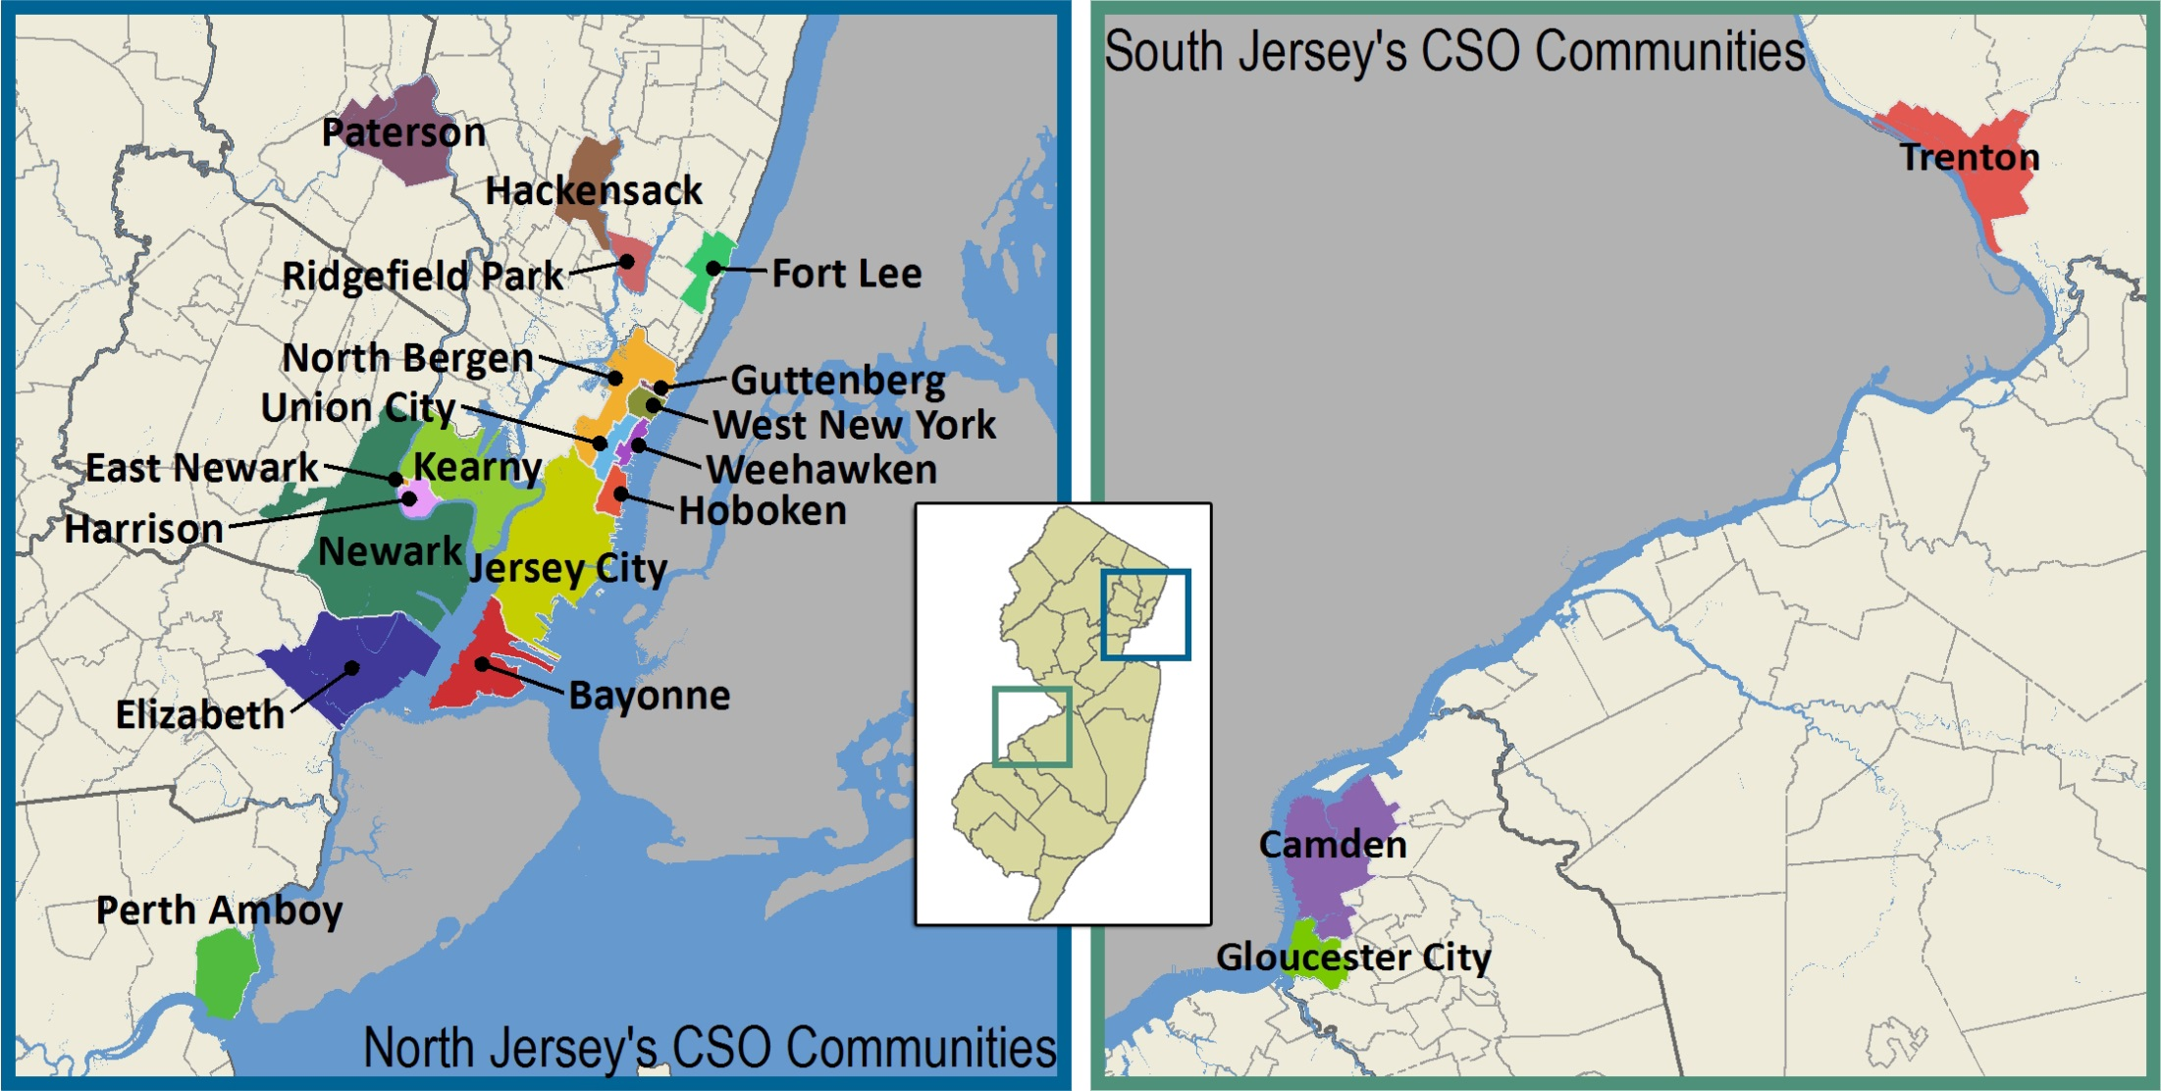
Where Are NJ CSOs?

Slide 7
What is the CSO Permit?
The goal is the develop plans that will meet requirements of the 1972 Clean Water Act and the National CSO Policy by reducing or eliminating the remaining CSO outfalls in New Jersey.
Fishable and swimmable waterways
Reduce flooding
Goal: 85 percent reduction in overflows or four overflow a year
Timeline: Implemented over the next 15 – 30 years
Notes:
DEP issued 25 permits to New Jersey municipalities, utilities and sewer treatment plants in 2015 that allows them to overflow until 2020 while meeting the following requirements:
Nine minimum controls
Ensure proper operation, maintenance and management of existing infrastructure
Provide opportunities for green infrastructure
Development and implementation of a Long Term Control Plan

Slide 8
Long Term Control Plans
The following are major deadlines:
July 1, 2018
System Characterization Report
Public Participation Process Report
Compliance Monitoring Program Report
Consideration of Sensitive Areas Plan
July 1, 2019
Development and Evaluation of Alternatives Report
July 1, 2020
Selection and Implementation of Alternatives Report in the Final LTCP
Notes:
In 2015, the New Jersey Department of Environmental Protection issued a new permit requiring the Jersey City MUA and 20 other cities/utilities to develop plans by 2020 to reduce sewage in our waterways.

Slide 9
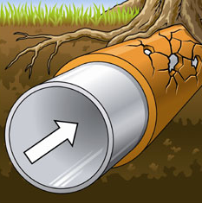
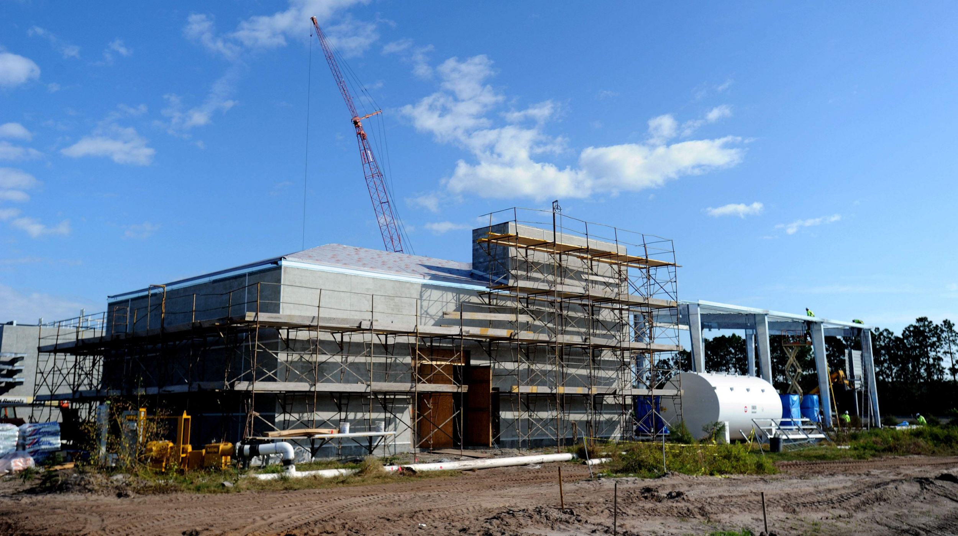
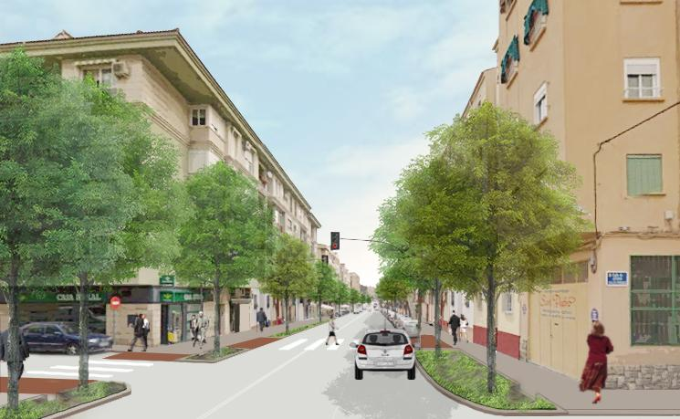
Alternatives Being Considered
Green infrastructure
Increased storage capacity in the collection system
Sewage treatment plant expansion and/or storage at the plant
Fix pipes to reduce leaks
Separate pipes for stormwater and sewer
CSO discharge treatment

Slide 10
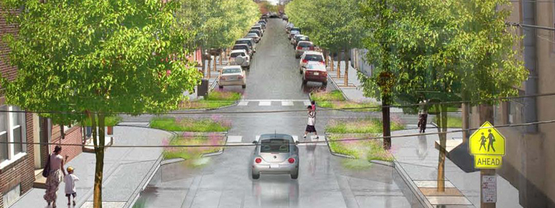
Green Infrastructure
Above-the-ground methods mimic nature by capturing stormwater so it can be reused or it can trickle into the ground.
Examples: Planting trees, building rain gardens, saving rainwater, and installing special pavement that allows water to filter through.
These methods also may help cool your neighborhood in the summer and provide protection from cold, save energy, clean the air, reduce flooding and add green space.

Slide 11
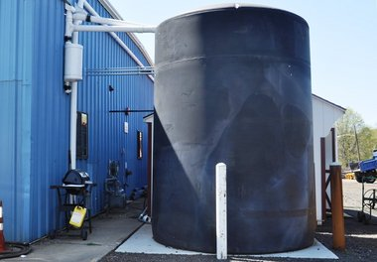
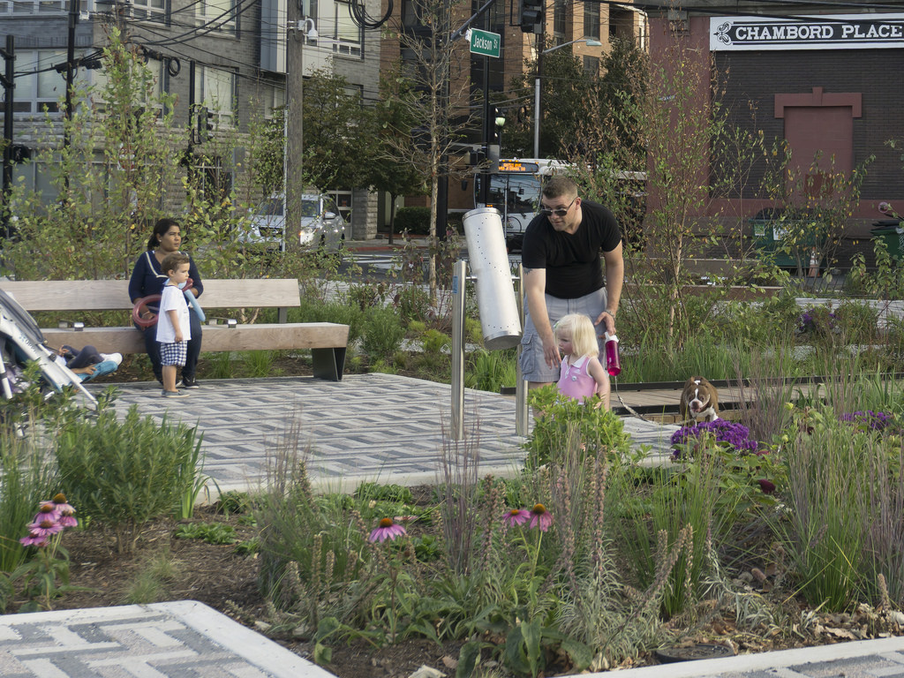
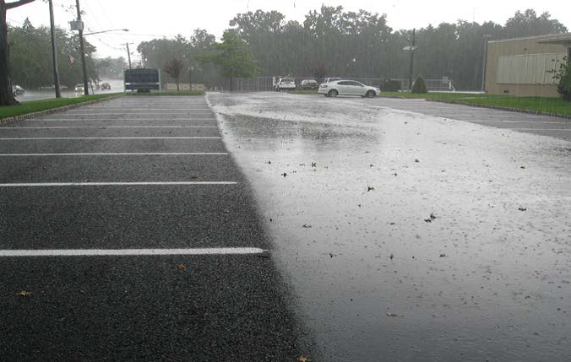

Slide 12
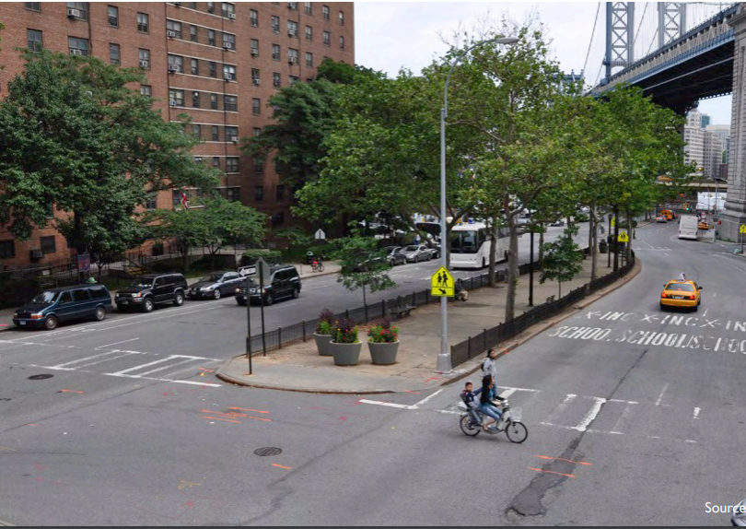
A street designed for cars

Slide 13
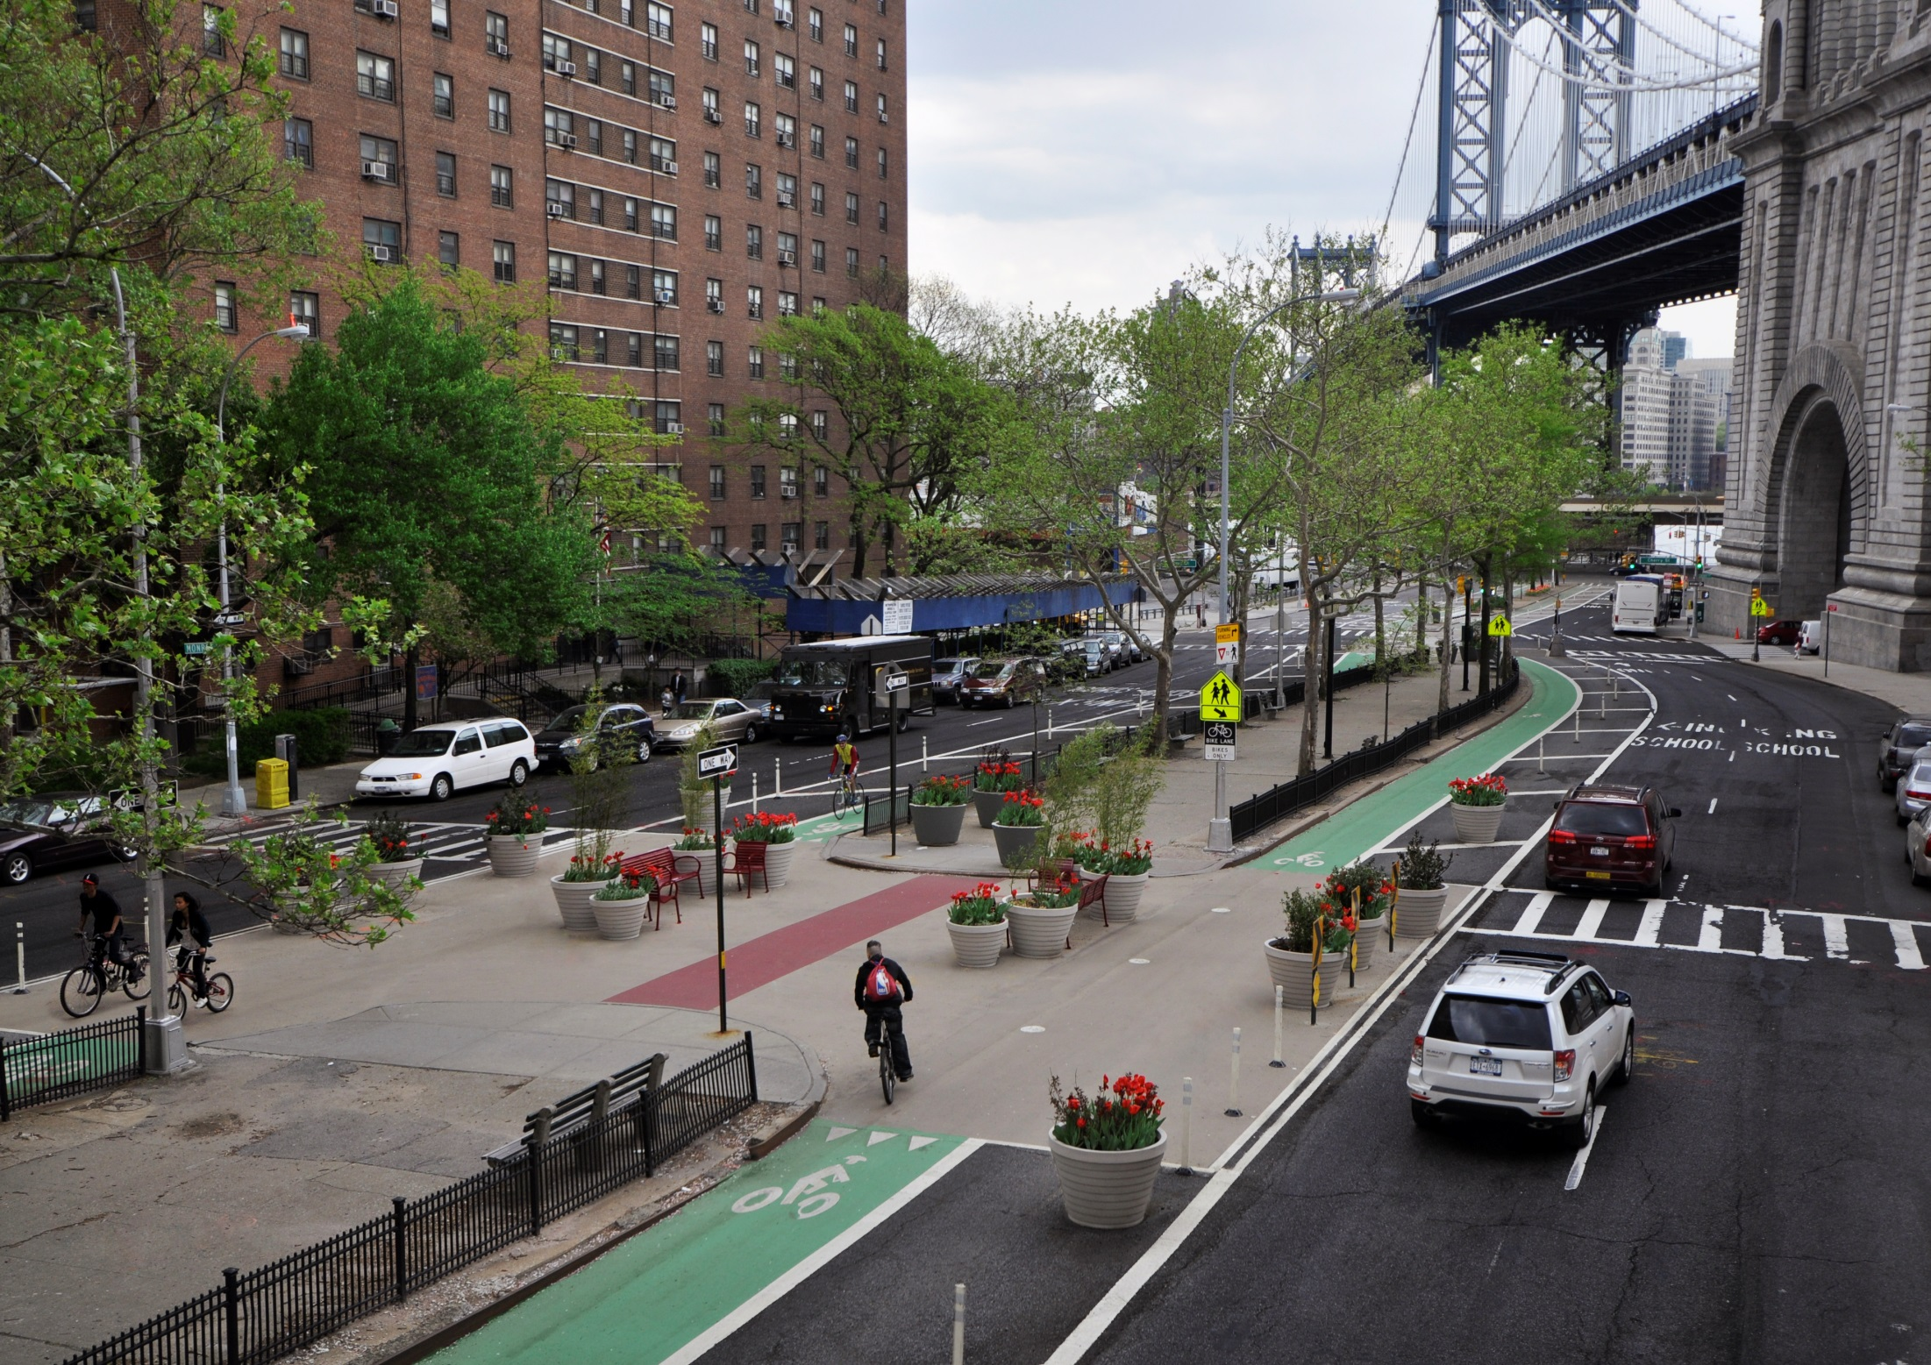
A complete street: Designed for pedestrians, bikes and cards

Slide 14
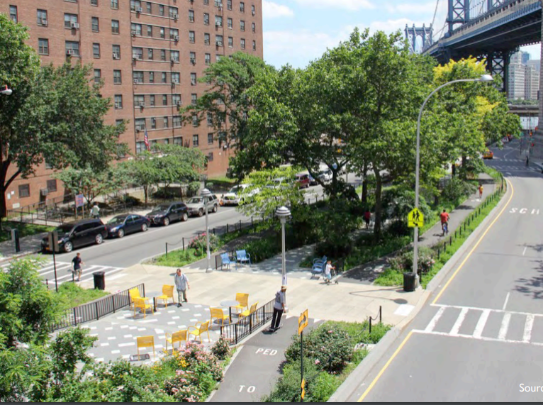
A complete and green street: Designed for pedestrians, bikes, cars and managing stormwater

Slide 15
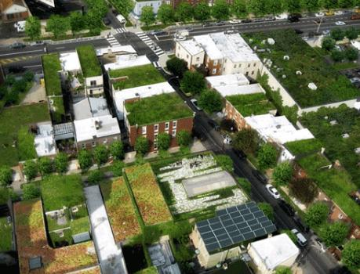
How is Green Infrastructure Being Used to Reduce CSOs?
City of Philadelphia sets sights on “the most comprehensive network of green infrastructure” 25 year plan
1st inch of rainfall for 30% of impervious cover over 25 years.
Less expensive than an all-gray approach
Community benefits

Slide 16
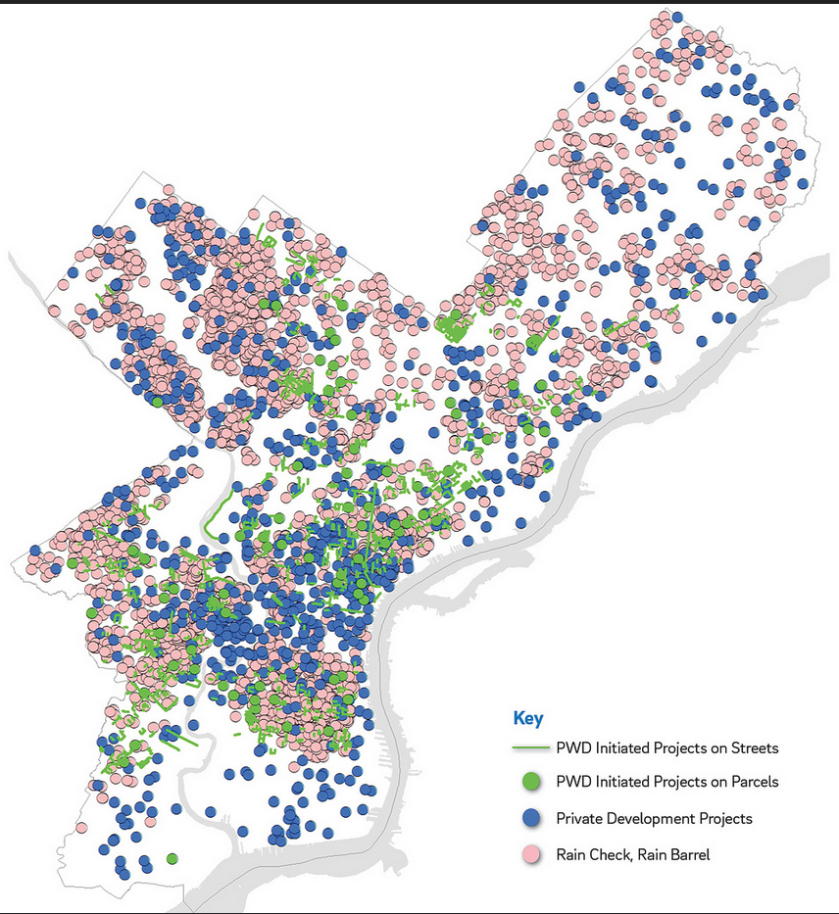
Philadelphia
After five years
440 green infrastructure sites
1.5 billion gallons per year managed

Slide 17
Philadelphia
After five years
308,759 citizens engaged
Hundreds of meetings and events
Result: Residents help shape the GI investments that are transforming their neighborhoods.

Slide 18
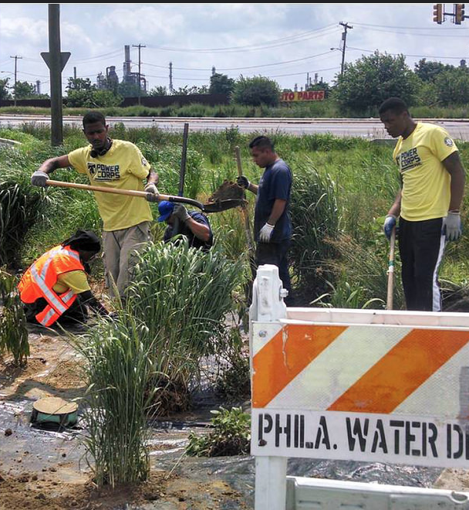
Philadelphia
After five years
430 new jobs, or 14 percent growth
Greater Philadelphia Green Infrastructure Industry, including members of PowerCorps PHL program for at risk-youth + local GI design and maintenance firms.

Slide 19
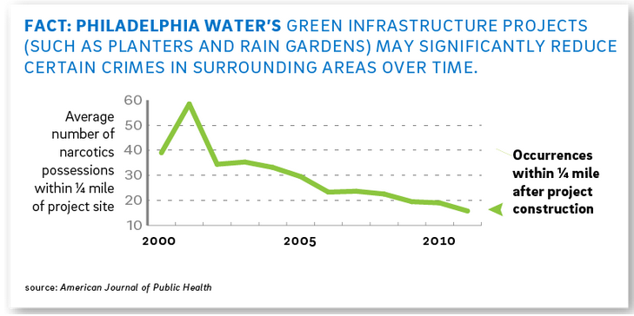
Triple-Bottom-Line Evaluation of Alternatives
Notes:
Cities like Philadelphia and Camden have evaluated their plans using a triple-bottom-line approach.
Plans are evaluated based on community priorities like; reducing adverse health effects from urban heat islands, increase property values, and reducing crime and increased green space.
And
Improved water quality and affordability/

Slide 20
Empowers community organizations to engage residents and small business owners to shape the solutions that will be adopted in 2020 to reduce localized flooding and the raw sewage dumped into our waterways.
Sewage-Free Streets and Rivers Statewide Campaign

Slide 21
We Support Long Term Control Plans processes that include:
Funding for public participation
A public conversation
Reflect community values
Deliver local benefits

Slide 22
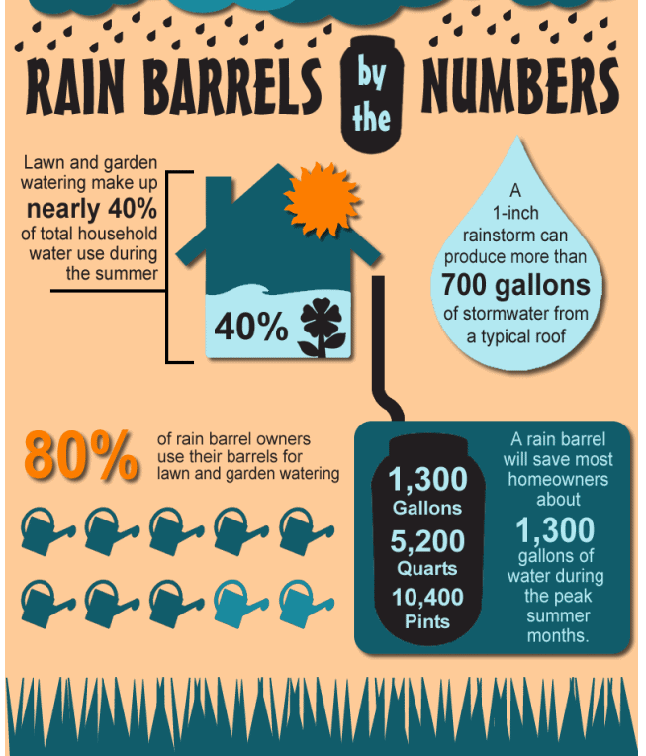
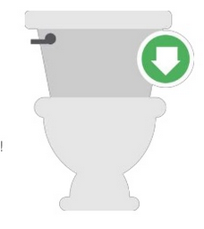
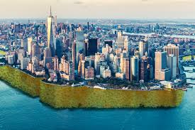
What can Jersey City residents
do to reduce impacts of CSOs?
Water conservation
Rain barrels
Adopt a catch basins
Keep our sewers clean
Tree plantings – 1 mature tree can absorb up to
100 gallons of water during a storm event.
Green infrastructure projects

Slide 23
Partners
Association of New Jersey Environmental Commissions
Canco Park Conservancy
Clean Water Action
Clean Water Advocacy Center
Cooper’s Ferry Partnership
The Embankment Preservation Coalition
Greener JC
Great Swamp Watershed Association
Hoboken Cove Community Boathouse
Hackensack Riverkeeper
I Love Greenville
Ironbound Community Corporation
Jersey City Environmental Commission
MnM Consulting
Morris Park Neighborhood Association
Natural Resources Defense Council
New Jersey Environmental Justice Alliance
New Jersey Future
Newark DIG
NJ/NY Baykeeper
New Jersey Tree Foundation
Paterson Habitat for Humanity
Pershing Field Neighborhood Association
Perth Amboy Civic Trust
Raritan Riverkeeper
Riverview Neighborhood Association
Resilience Paddle Sports
Sustainable Jersey City

Slide 24
Advisory Board
Meredith Brown, The Tree Foundation
Drew Curtis, Ironbound Community Corporation
Kim Gaddy, Clean Water Action.
Stephen Kehayes, Paterson Habitat for Humanity
Mo Kinberg, New Jersey Future.
Michele Langa, Hackensack Riverkeeper
Nicole Miller, Newark DIG (Doing Infrastructure Green)
Greg Remaud, NY/NJ Baykeeper.
Rosana DaSilva, The New York – New Jersey Harbor & Estuary Program (HEP
Chris Obropta, Rutgers Cooperative Extension Water Resource Program (RCEWRP).

Slide 25
Website: SewageFreeNJ.org
Twitter: SewageFreeNJ
Facebook: SewageFreeNJ
Email: info@sewagefreenj.org

